Slide 1
CSE 12 – Basic Data Structures and Object-Oriented Design Lecture 8
Greg Miranda, Fall 2020
This lecture is being recorded

Slide 2
Announcements
Quiz 8 due Wednesday @ 9am
Survey 3 due Friday @ 11:59pm
PA2 due Wednesday @ 11:59pm

Slide 3
Topics
Questions on Lecture 8?
BFS/DFS

Slide 4
Questions on Lecture 8?

Slide 5
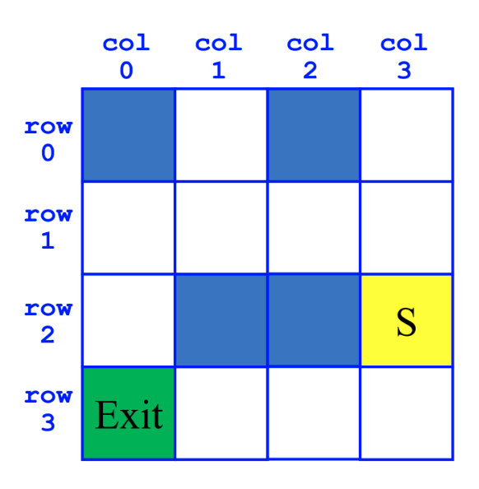
Breadth-First Search (BFS)
SearchForTheExit
Initialize a Queue to hold Squares as we search
Mark starting square as visited
Enqueue starting square on Queue
While Queue is not empty
Dequeue square sq from Queue
Mark sq as visited
If sq is the Exit, we're done!
For each of square's unvisited neighbors (S, W, N, E):
Set neighbor's previous to sq
Enqueue neighbor to Queue

Slide 6
Depth-First Search (DFS)
SearchForTheExit
Initialize a Stack to hold Squares as we search
Mark starting square as visited
Push starting square on Stack
While Stack is not empty
Pop square sq from Stack
Mark sq as visited
If sq is the Exit, we're done!
For each of square's unvisited neighbors (S, W, N, E):
Set neighbor's previous to sq
Push neighbor to Stack

